Slide 1
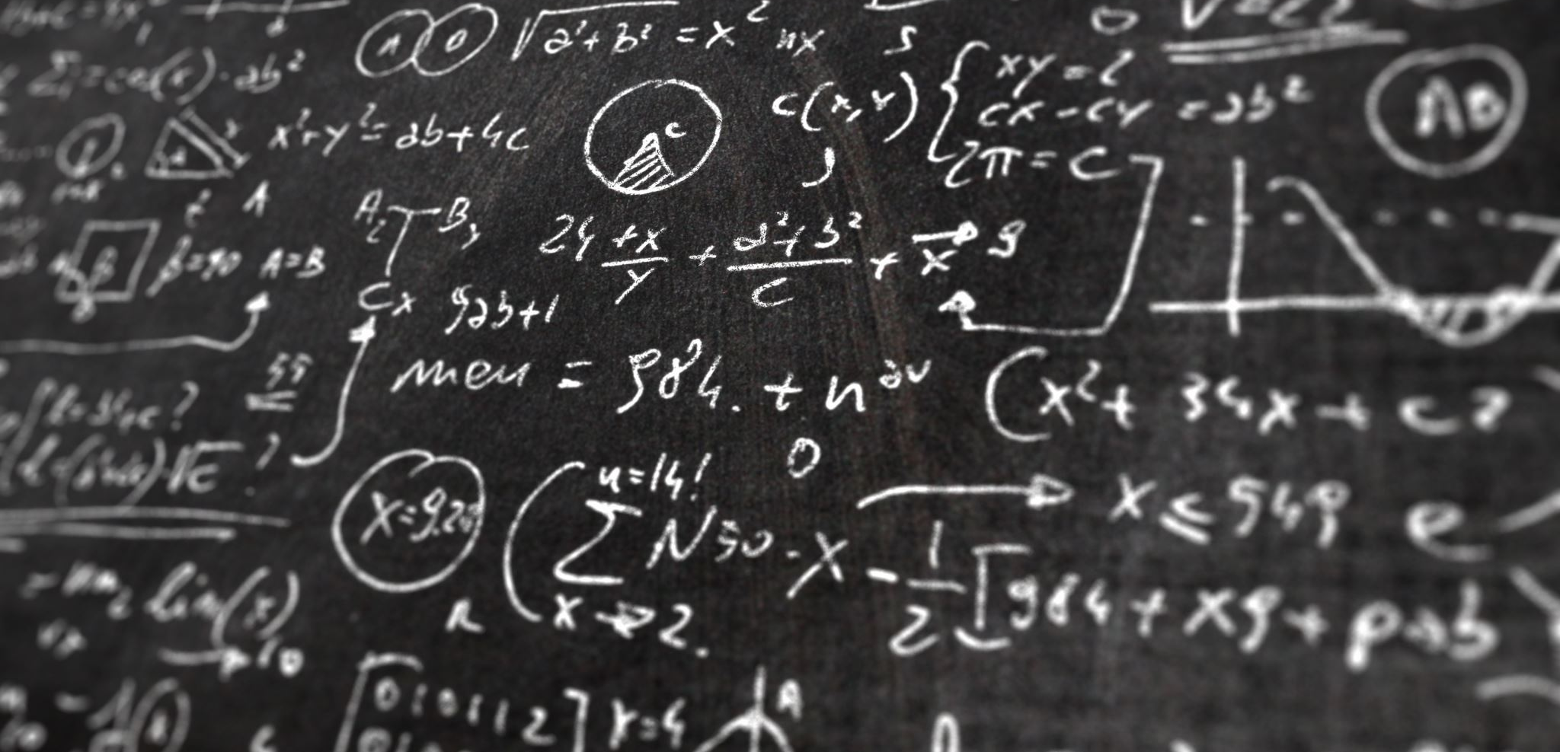
Study on Transition of Image Classification – Code Implementation from AlexNet to Vision Transformer
Juan Park, Sogang Lee, Jeongkyu Lee, Georyang Park, Jiseok Son
Notes:
이미지 분류 연구 동향 및 코드구현- AlexNet 부터 Vision Transformer까지
Study on Transition of Image Classification – Code Implementation from AlexNet to Vision Transformer

Slide 2
01. INTRODUCTION
T A B L E
O F
C O N T E N T S
SUMMARY
PURPOSE OF STUDY
CNN MODEL ARCHITECTURE
TRANSFORMER MODEL ARCHITECTURE
02. METHOD
DATASET
DATA PREPROCESSING
CNN MODELING
TRANSFORMER MODELING
Study on Transition of Image Classification – Code Implementation from AlexNet to Vision Transformer
03. RESULT
TEST RESULT
DISCUSSION

Slide 3
Introduction

Slide 4










SUMMARY
01
02
03
DATA
PREPROCESSING
BUILD MODEL
TRAINING
RESULT
VISUALIZING
EVALUATION
06
05
04

Slide 5
Purpose of Study
- 컴퓨터 비전 분야 중 이미지 분류 모델 논문 코드 구현 및 평가
- CNN 딥러닝 모델들의 특징 분석 및 평가
- Transformer 딥러닝 모델의 특징 분석 및 평가

Slide 6
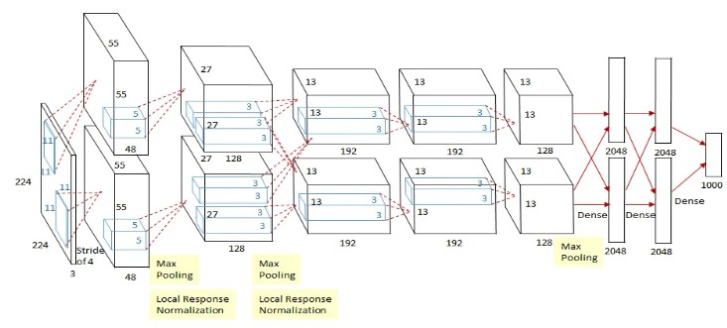
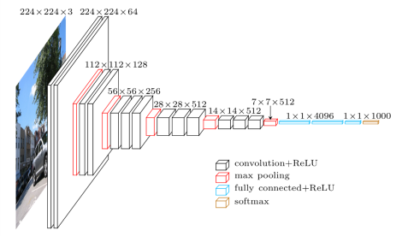
CNN Model Architecture
AlexNet : Krizhevsky et al.(2012)
VGGNet : Simonyan, K. & Zisserman, A.(2014)

Slide 7
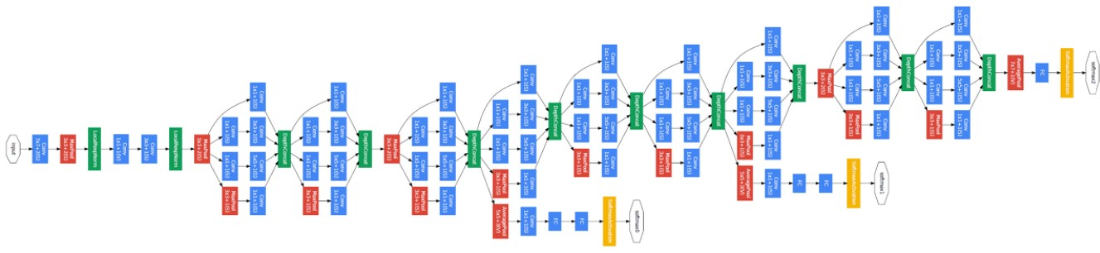
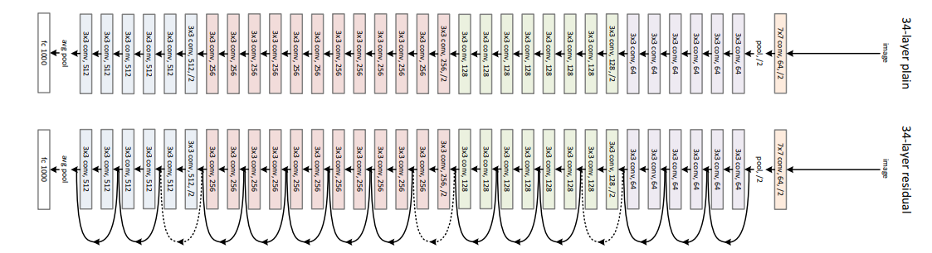
CNN Model Architecture
GoogLeNet : C. Szegedy et al.(2014)
ResNet : K. He et al.(2016)

Slide 8
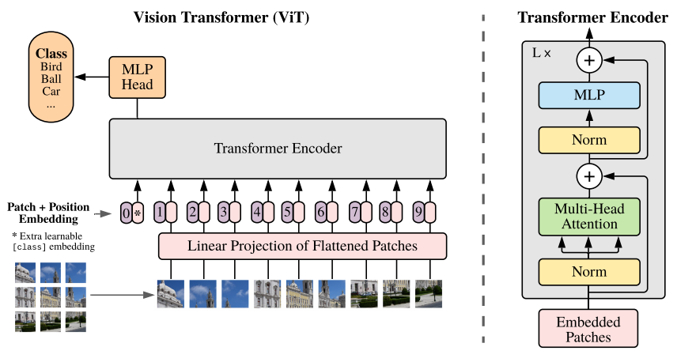
Transformer Model Architecture
ViT : Dosovitskiy, A. et al.(2020)

Slide 9
Method

Slide 10
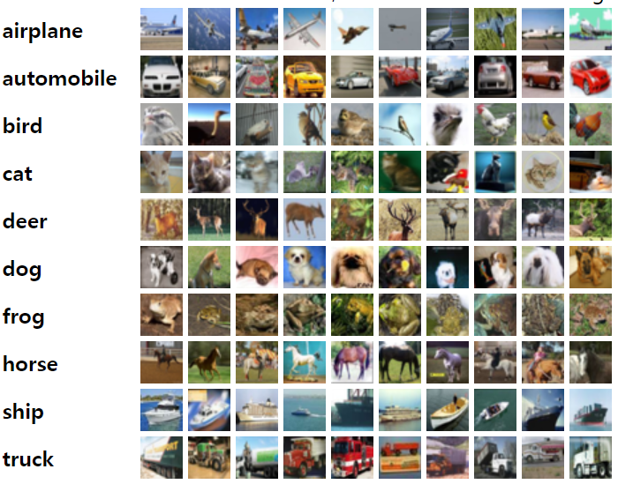
CIFAR10
Dataset
60,000 images
10 classes
50,000 Training data
10,000 test data

Slide 11
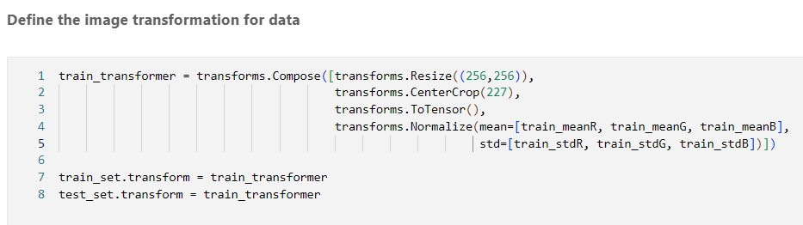
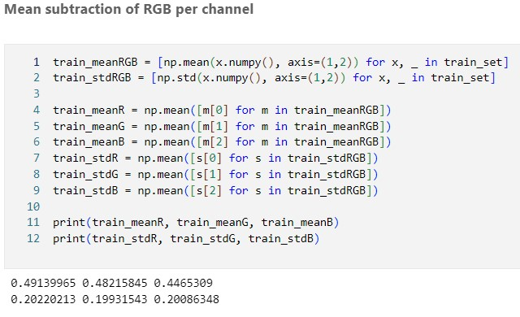
PReprocessing
Data Preprocessing
AlexNet based Resize and Center crop
- resize - Center crop - Normalize by RGb channel
(mean, std)
Commonly applied to all models

Slide 12
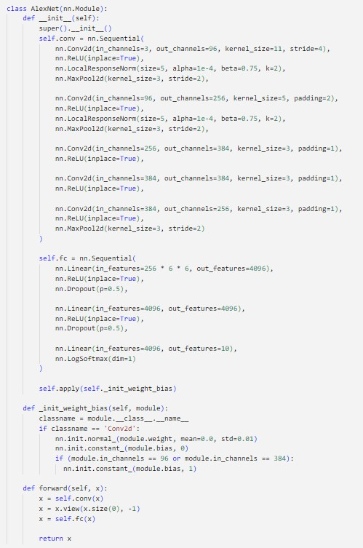
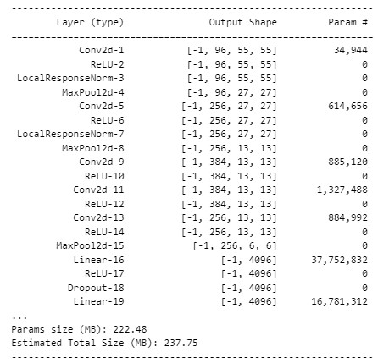
A L E x n e t
CNN Modeling - AlexNet
- LRN (local response normalization)
AlexNet
Model Summary

Slide 13
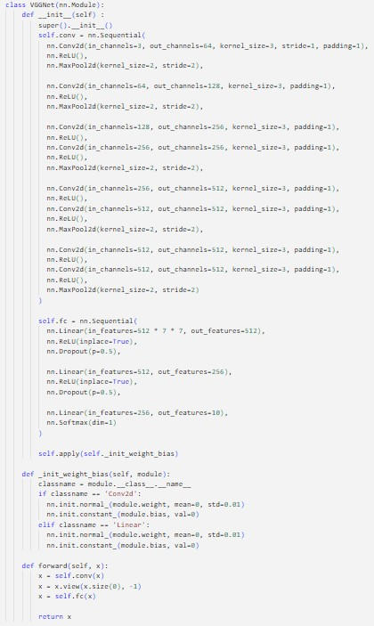
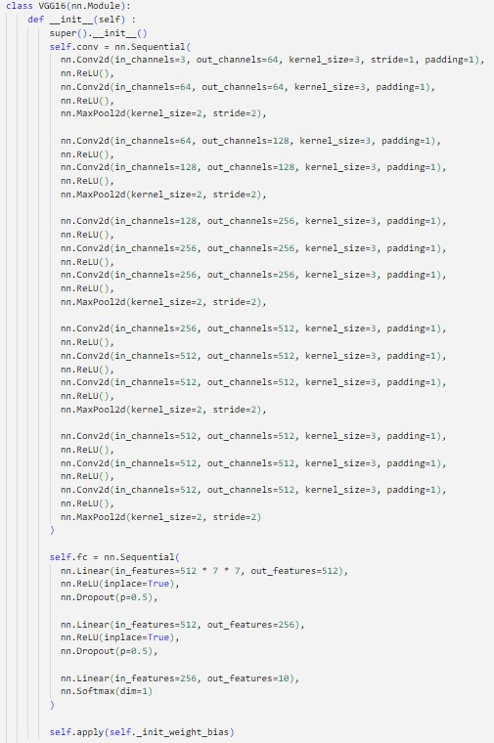
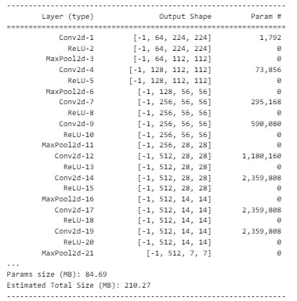
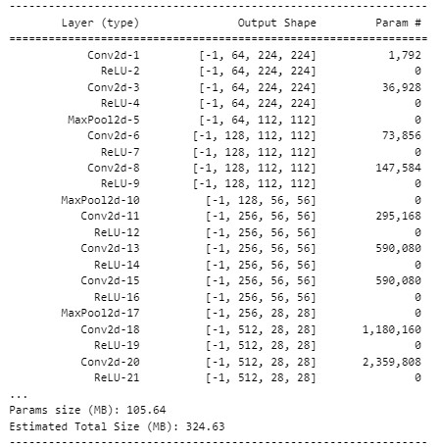
V g g n e t
CNN Modeling - VGGNet
VGGNet11
VGGNet16
VGGnet 11
Vggnet 16
3x3 receptive field
VGGNet11 Summary
VGGNet16 Summary

Slide 14
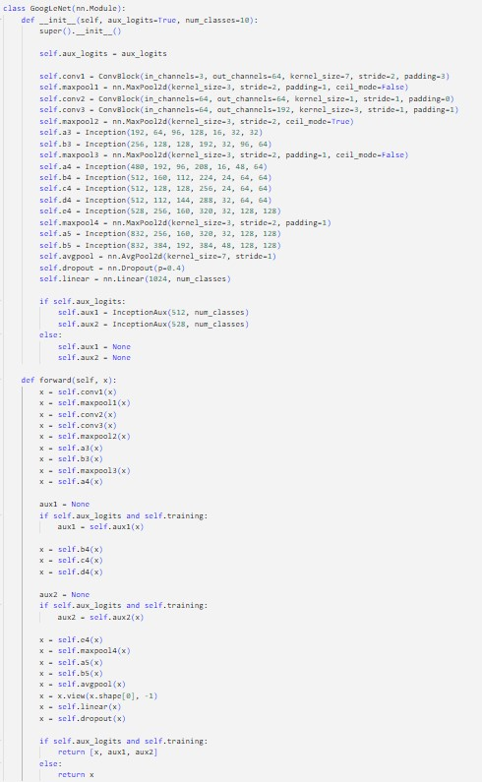
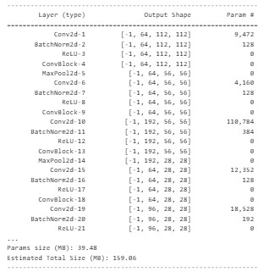
G o o g l e n e t
CNN Modeling - GoogLeNet
Inception Modules
Global Average Pooling
Auxiliary classifier
GoogLeNet
GoogLeNet Summary

Slide 15
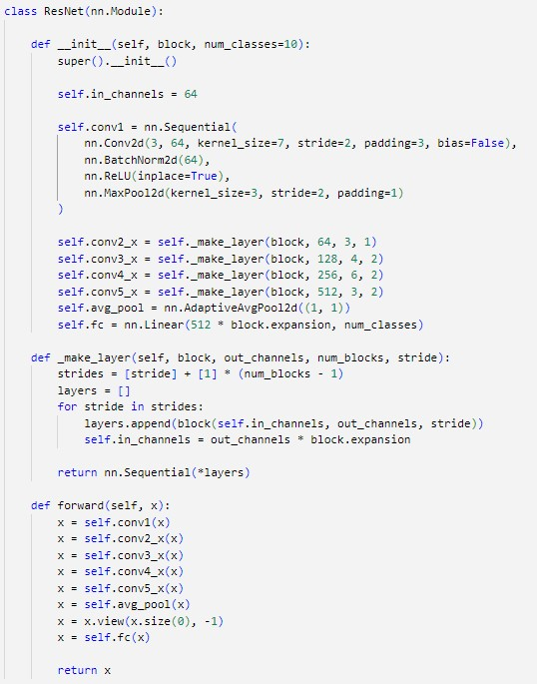
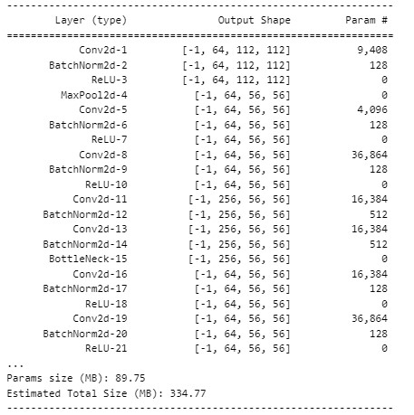
R e s n e t
CNN Modeling - ResNet
- Resnet projection
(Bottle neck Building block)
- Batch normalization
ResNet
ResNet Summary

Slide 16
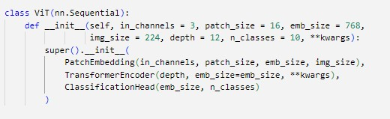
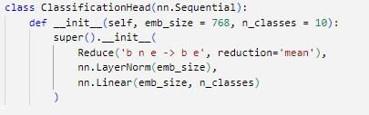
V I s I o n t r a n s f o r m e r
Transformer Modeling - ViT
Class Vision Transformer
Patch Embedding
Classification Head
Transformer Encoder
Patch embedding
Transformer encoder
Multihead attention
Residual add
feed forward block/ MLP
Transformer Encoder Block

Slide 17
V I s I o n t r a n s f o r m e r
Transformer Modeling - ViT
Residual Add
Multihead Attention
Feed Forward Block(MLP layer)
Patch embedding
Transformer encoder
Multihead attention
Residual add
feed forward block/ MLP

Slide 18
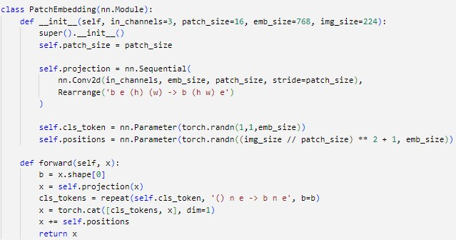

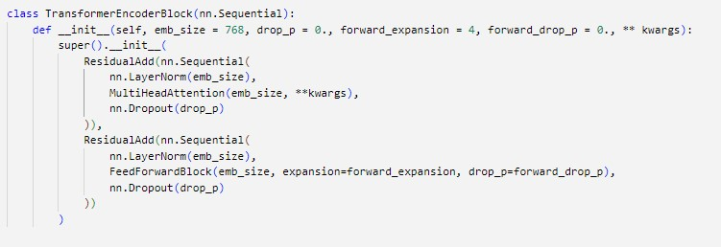
V I s I o n t r a n s f o r m e r
Transformer Modeling - ViT
Patch embedding
Transformer encoder
Multihead attention
Residual add
feed forward block/ MLP

Slide 19
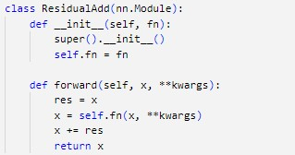
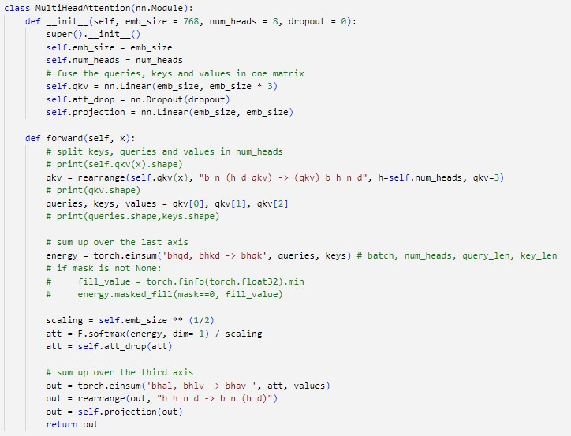
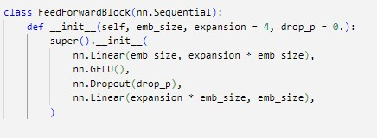
V I s I o n t r a n s f o r m e r
Transformer Modeling - ViT
Patch embedding
Transformer encoder
Multihead attention
Residual add
feed forward block/ MLP

Slide 20
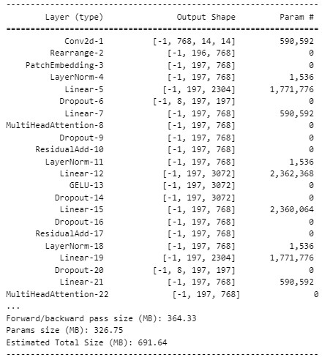
V I s I o n t r a n s f o r m e r
Transformer Modeling - ViT
Patch embedding
Transformer encoder
Multihead attention
Residual add
feed forward block/ MLP
Vision Transformer(ViT)
ViT Summary

Slide 21
Result

Slide 22
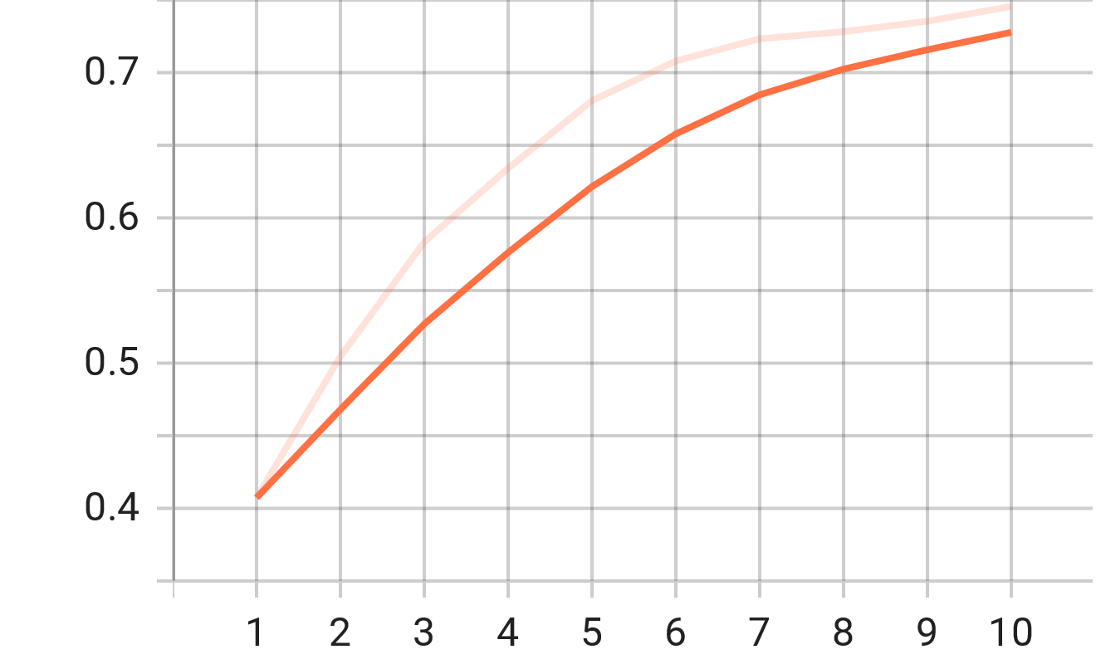
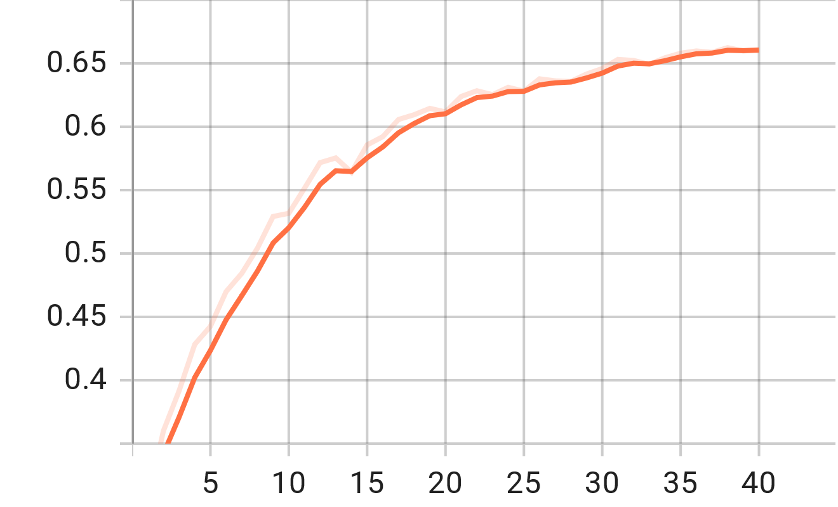
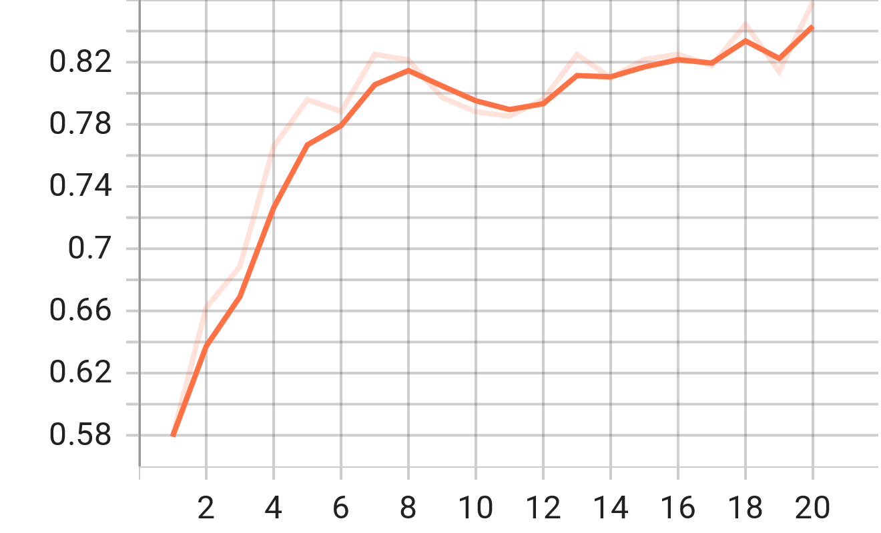
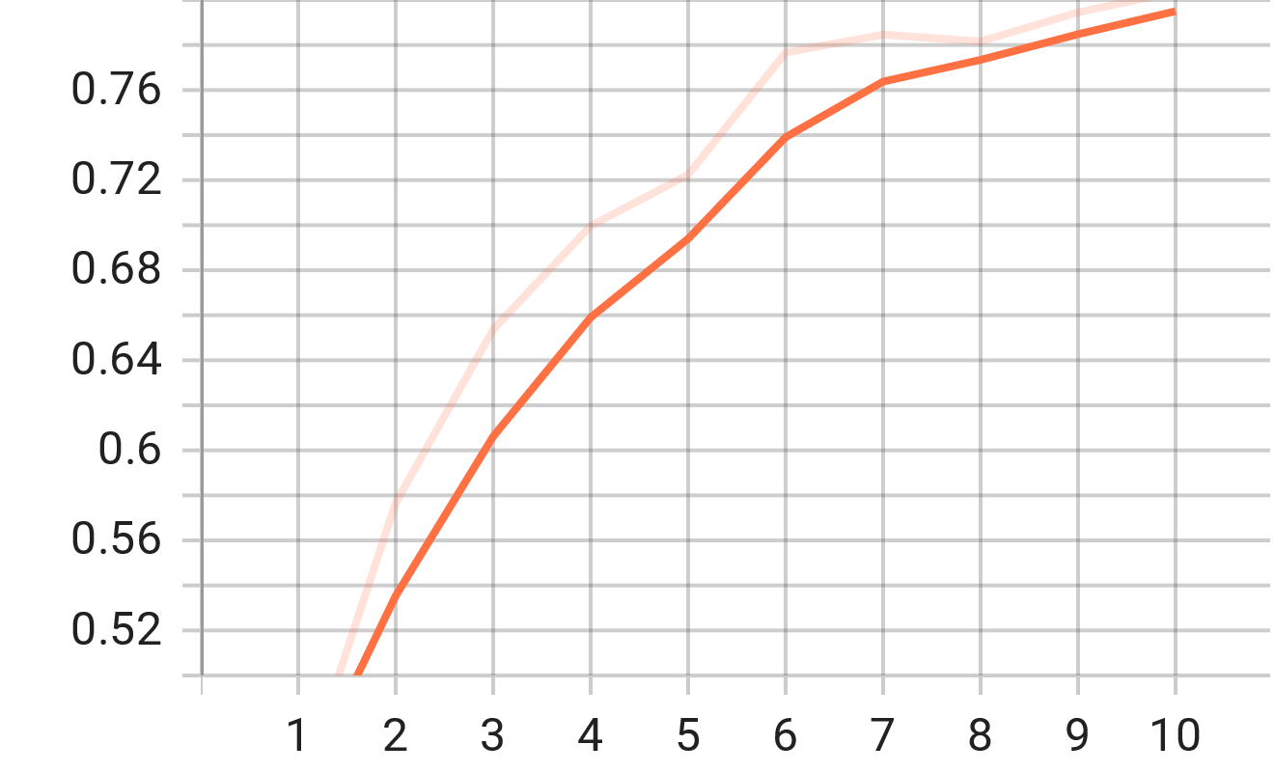
Accuracy
CNN Models
AlexNet
VGGNet
GoogleNet
ResNet

Slide 23
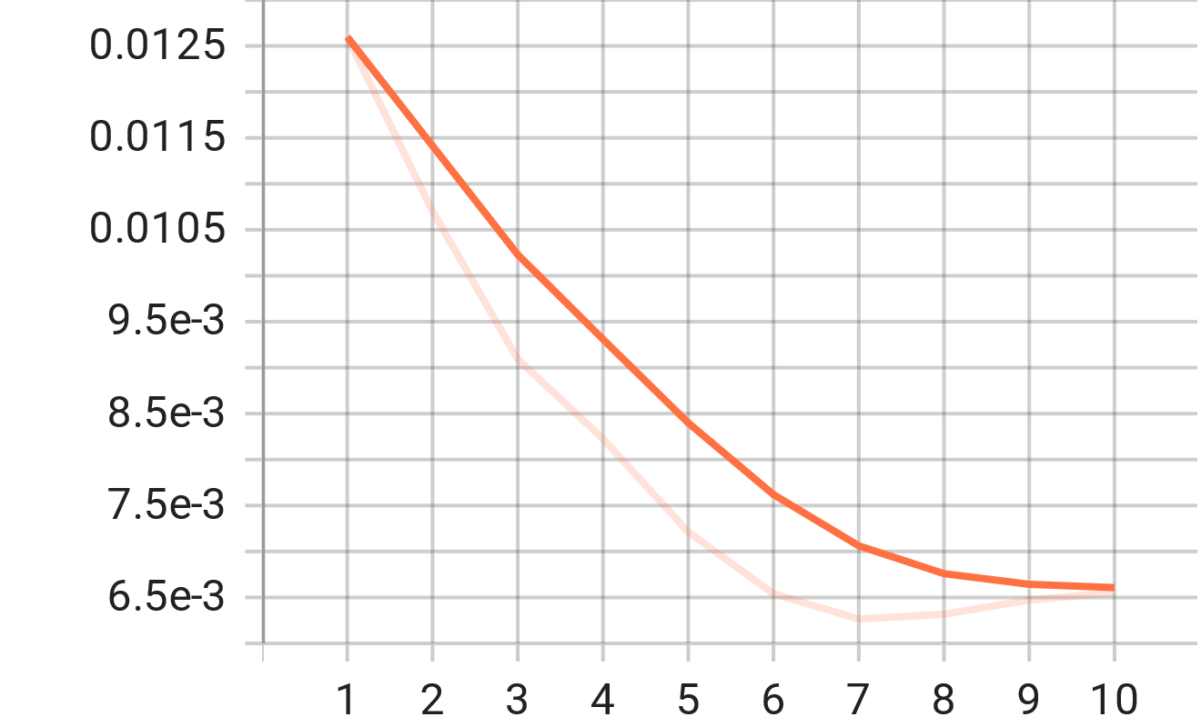
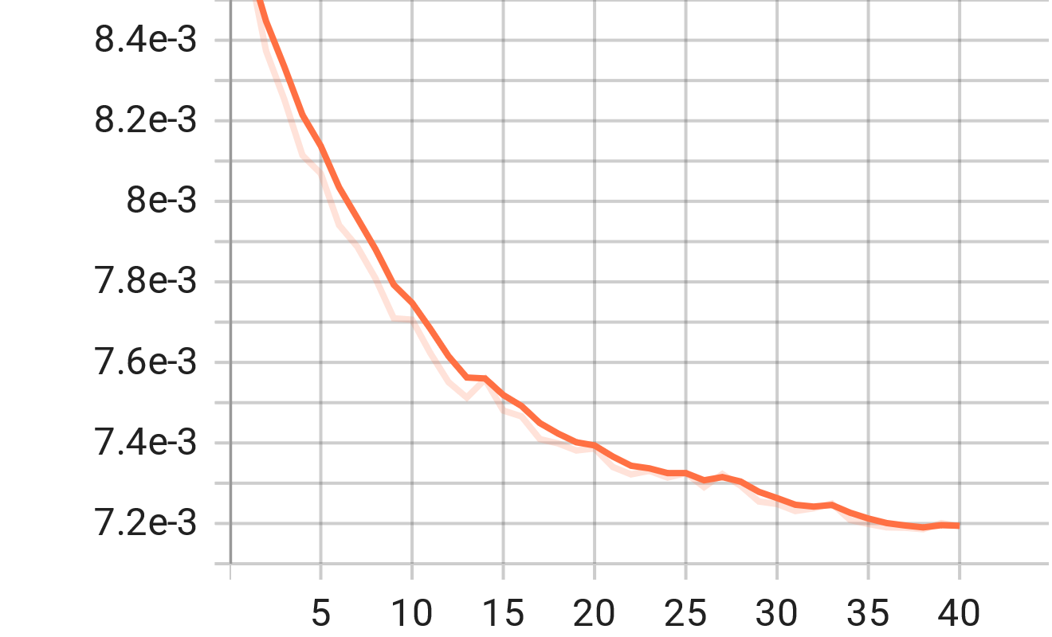
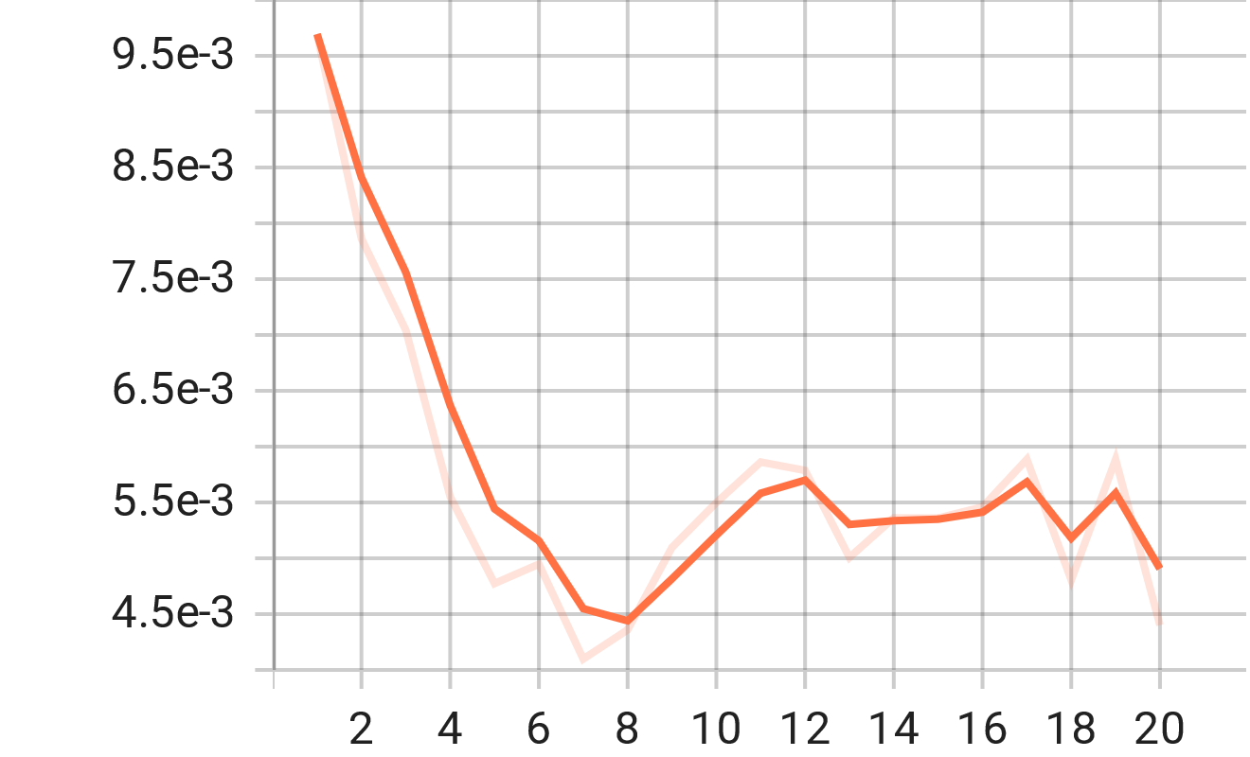
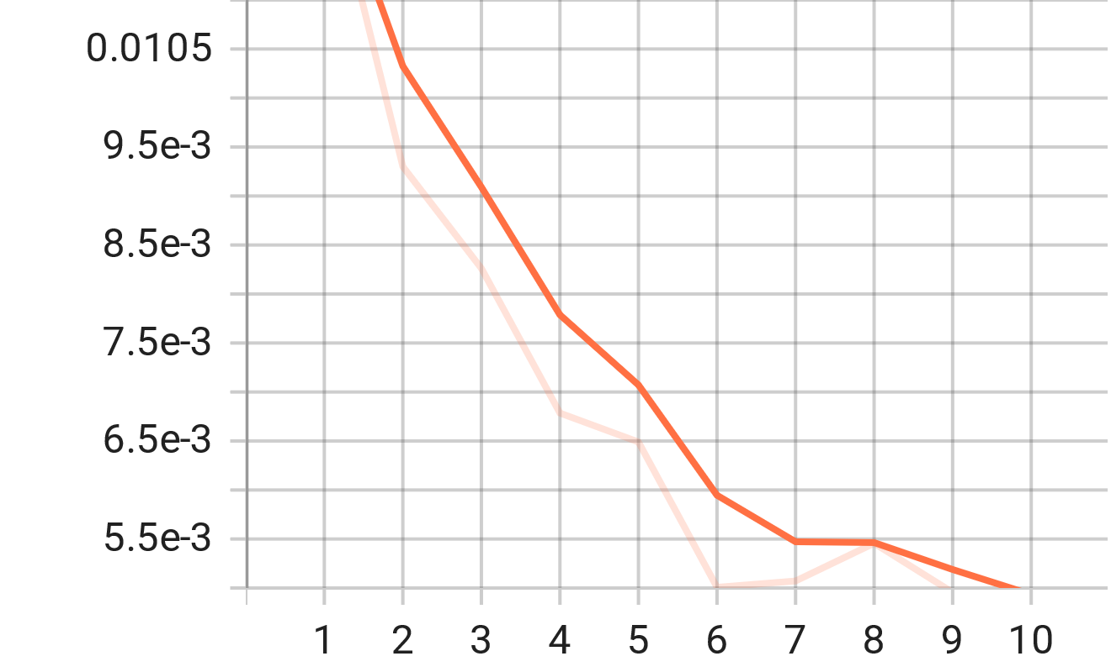
LOSS
CNN Models
AlexNet
VGGNet
GoogleNet
ResNet

Slide 24
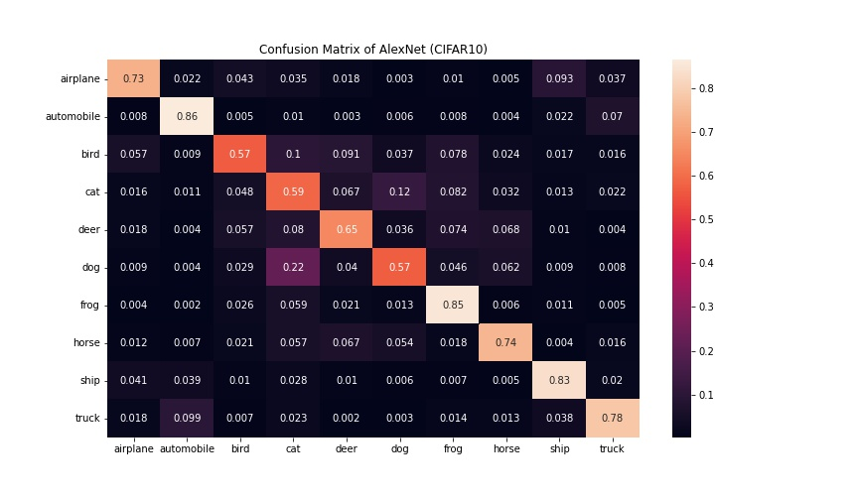
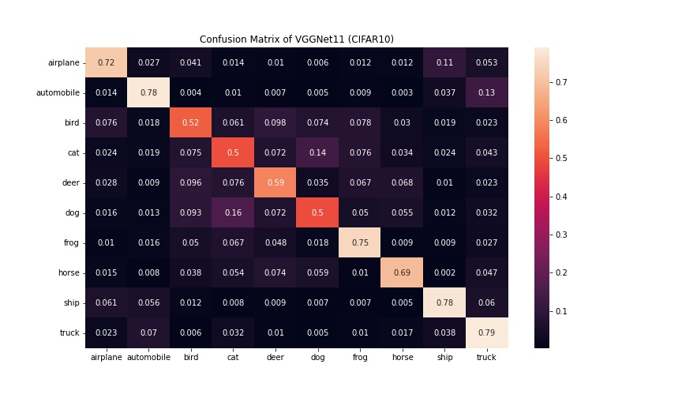
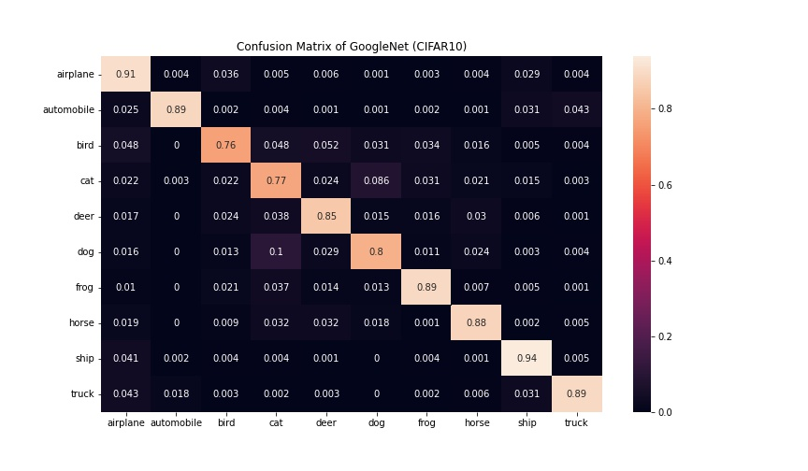
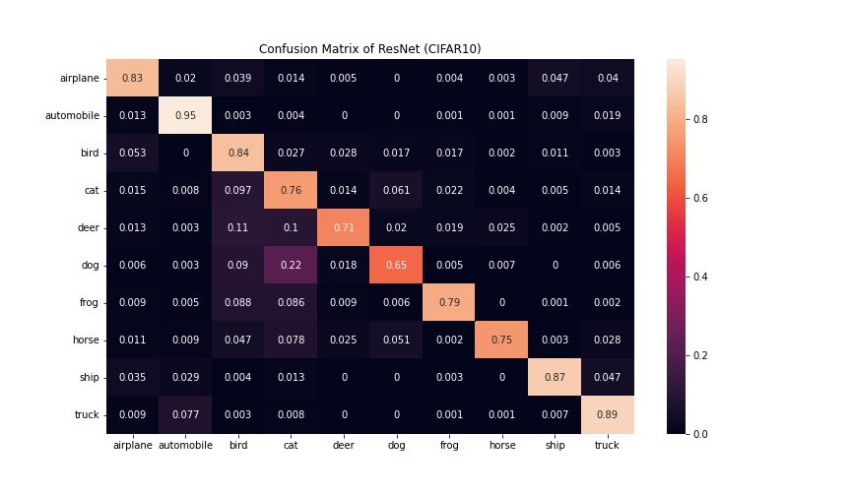
Confusion matrix
CNN Models
AlexNet
VGGNet
GoogleNet
ResNet

Slide 25
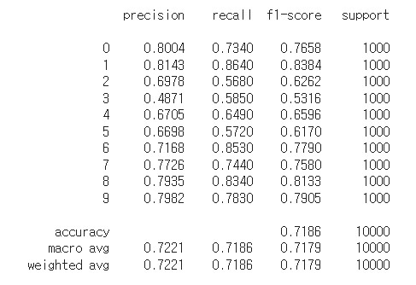
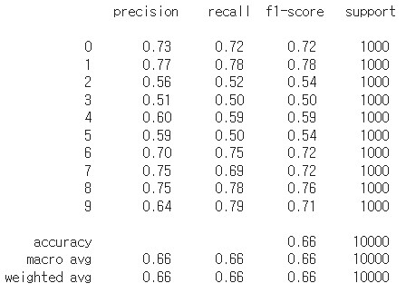
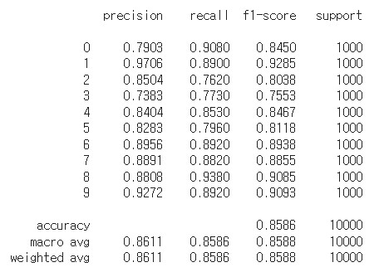
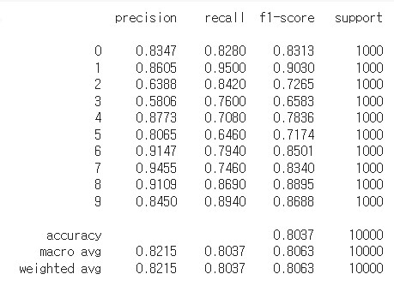
Classification report
CNN Models
AlexNet
VGGNet
GoogleNet
ResNet

Slide 26
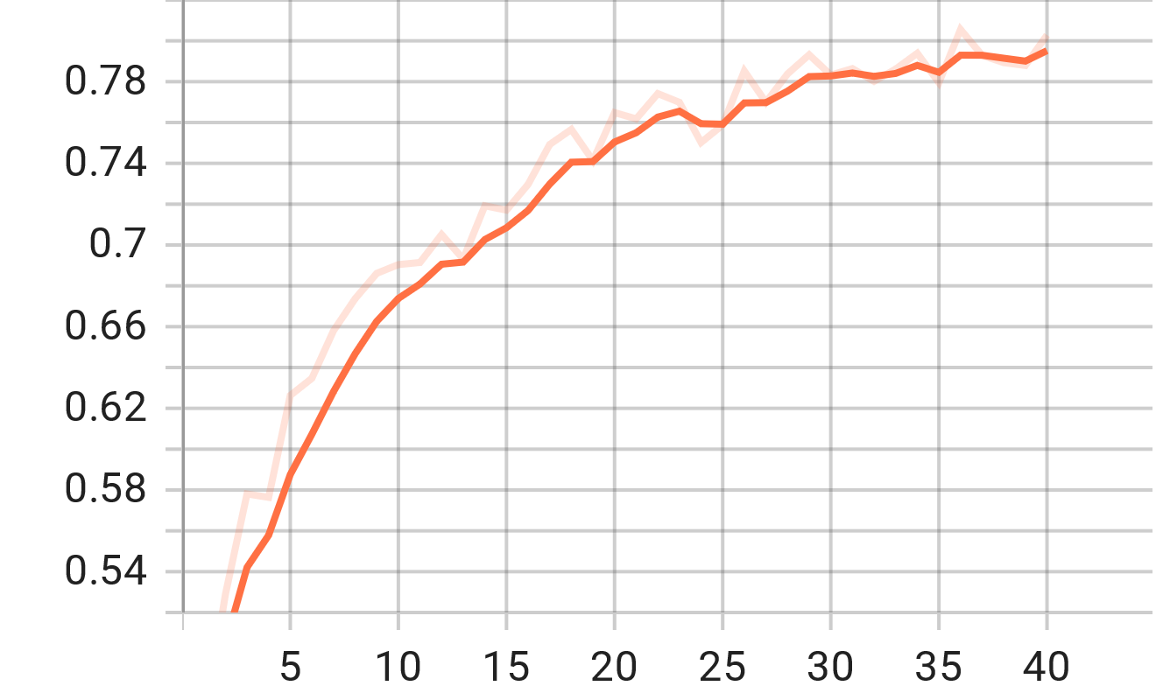
Accuracy
Transformer Model
Vision Transformer

Slide 27
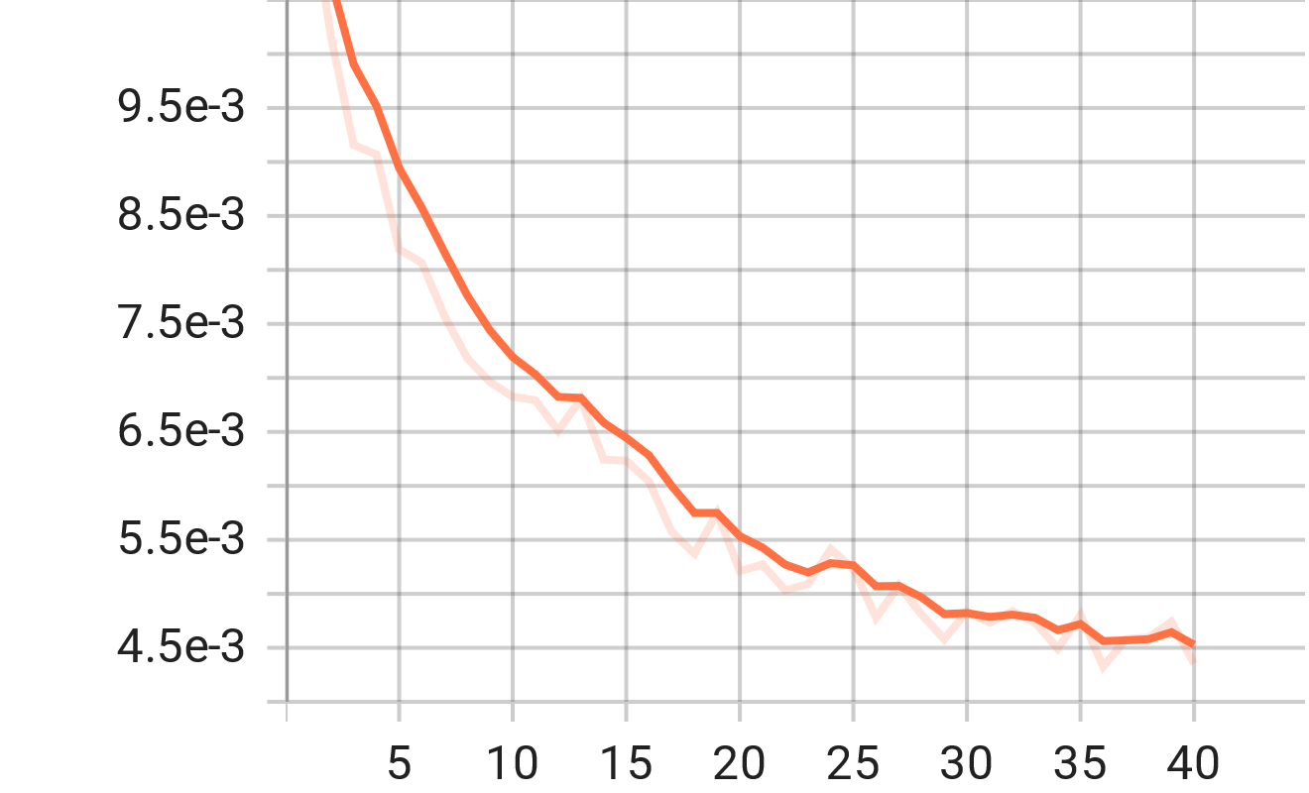
loss
Transformer Model
Vision Transformer

Slide 28
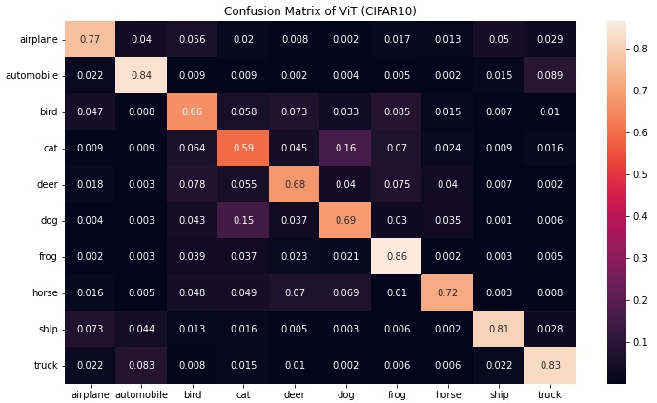
Confusion matrix
Transformer Model
Vision Transformer

Slide 29
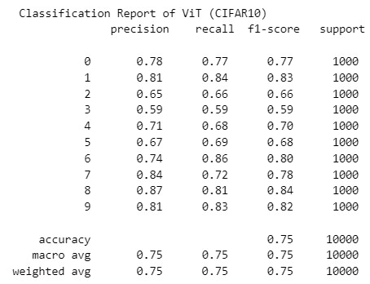
Classification report
Transformer Model
Vision Transformer

Slide 30
Thank you

